Slide 1
INTERNET PROGRAMMING AND MOBILE PROGRAMMING
GROUP 13
SYSTEM DESIGN AND MODELING

Slide 2


Table of Contents
1
Introduction
2
Context Diagram
3
Use case Diagram
4
Sequence Diagram
5
Class Diagram
5
6
6
Deployment Diagram

Slide 3

Introduction
Project Objectives
The main objective of this report are:
To illustrate the system design through various modeling techniques.
To provide a detailed understanding of the system’s components and their interactions.
To offer a blueprint for implementation that ensures the system’s functionality and reliability.

Slide 4
Project Scope
The scope of this report includes the design and modeling of the Biometric Student Attendance system, focusing on the following diagrams:
Context Diagram
Use case Diagram
Sequence Diagram
Class Diagram
Deployment Diagram

Slide 5
Context Diagram Overview
Context diagram provides a visual representation of the Biometric Student Attendance Mobile Application and its interaction with various external entities.

Slide 6
External Entities
The key external entities interaction with our Biometric Student Attendance Mobile Application are:
Students
Instructors
Administrators

Slide 7
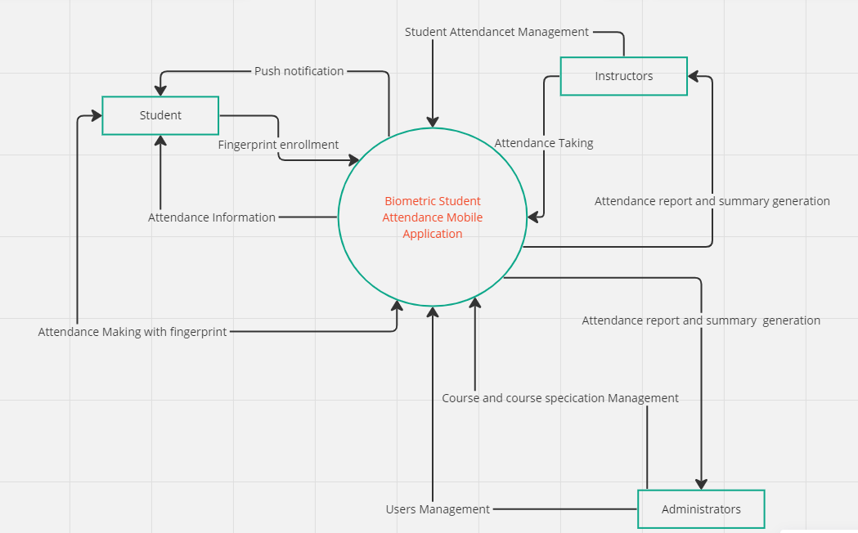
Context Diagram

Slide 8
Use case Diagram Overview
Use case diagram provides a visual representation of how users interact with a system. It serves as a blueprint for understanding the functional requirements of the system from a user’s perspective aiding in communication between stakeholders.

Slide 9
Key main actors
Students
Instructors
Administrators

Slide 10
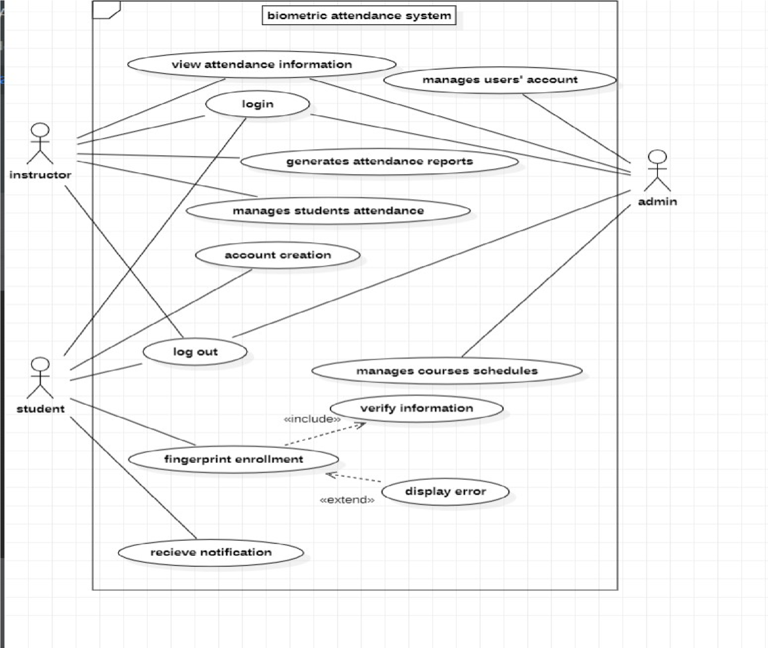
Use Case Diagram

Slide 11
Sequence Diagram Overview
Sequence diagram is an interaction diagram that details how operations are carried out what messages are sent and when. It consist of group of objects that are represented by lifelines, messages that they exchange overtime during the interaction.

Slide 12
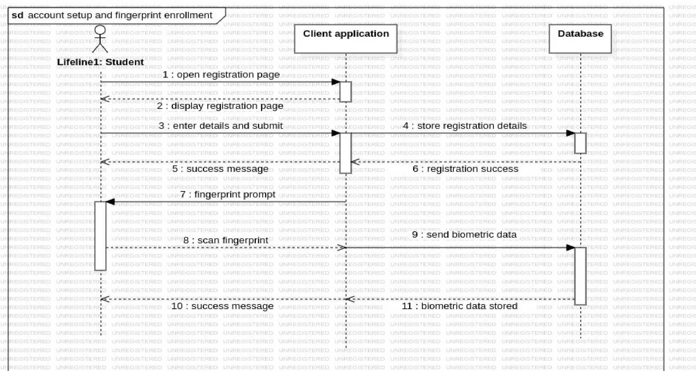
Account setup and fingerprint enrollment Scenario

Slide 13
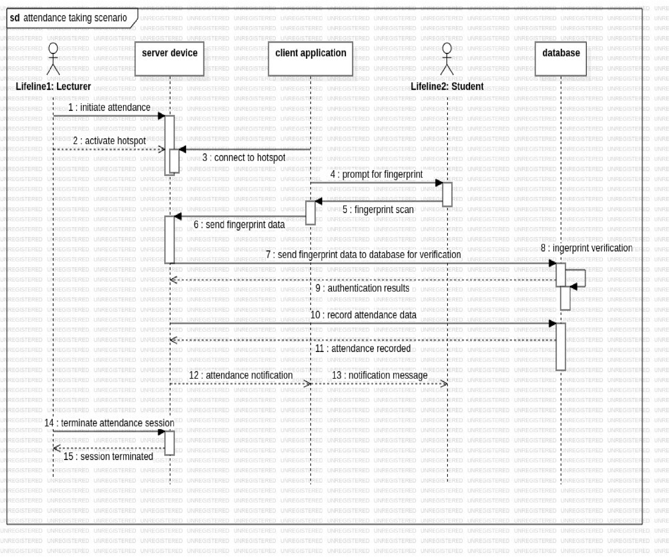
Attendance Taking Scenario
Attendance Taking Scenario

Slide 14
Class Diagram Overview
A class diagram is a types of static structure diagram used in software engineering and design to describe the structure of a system by showing its classes, attributes, methods and the relationships among objects.

Slide 15
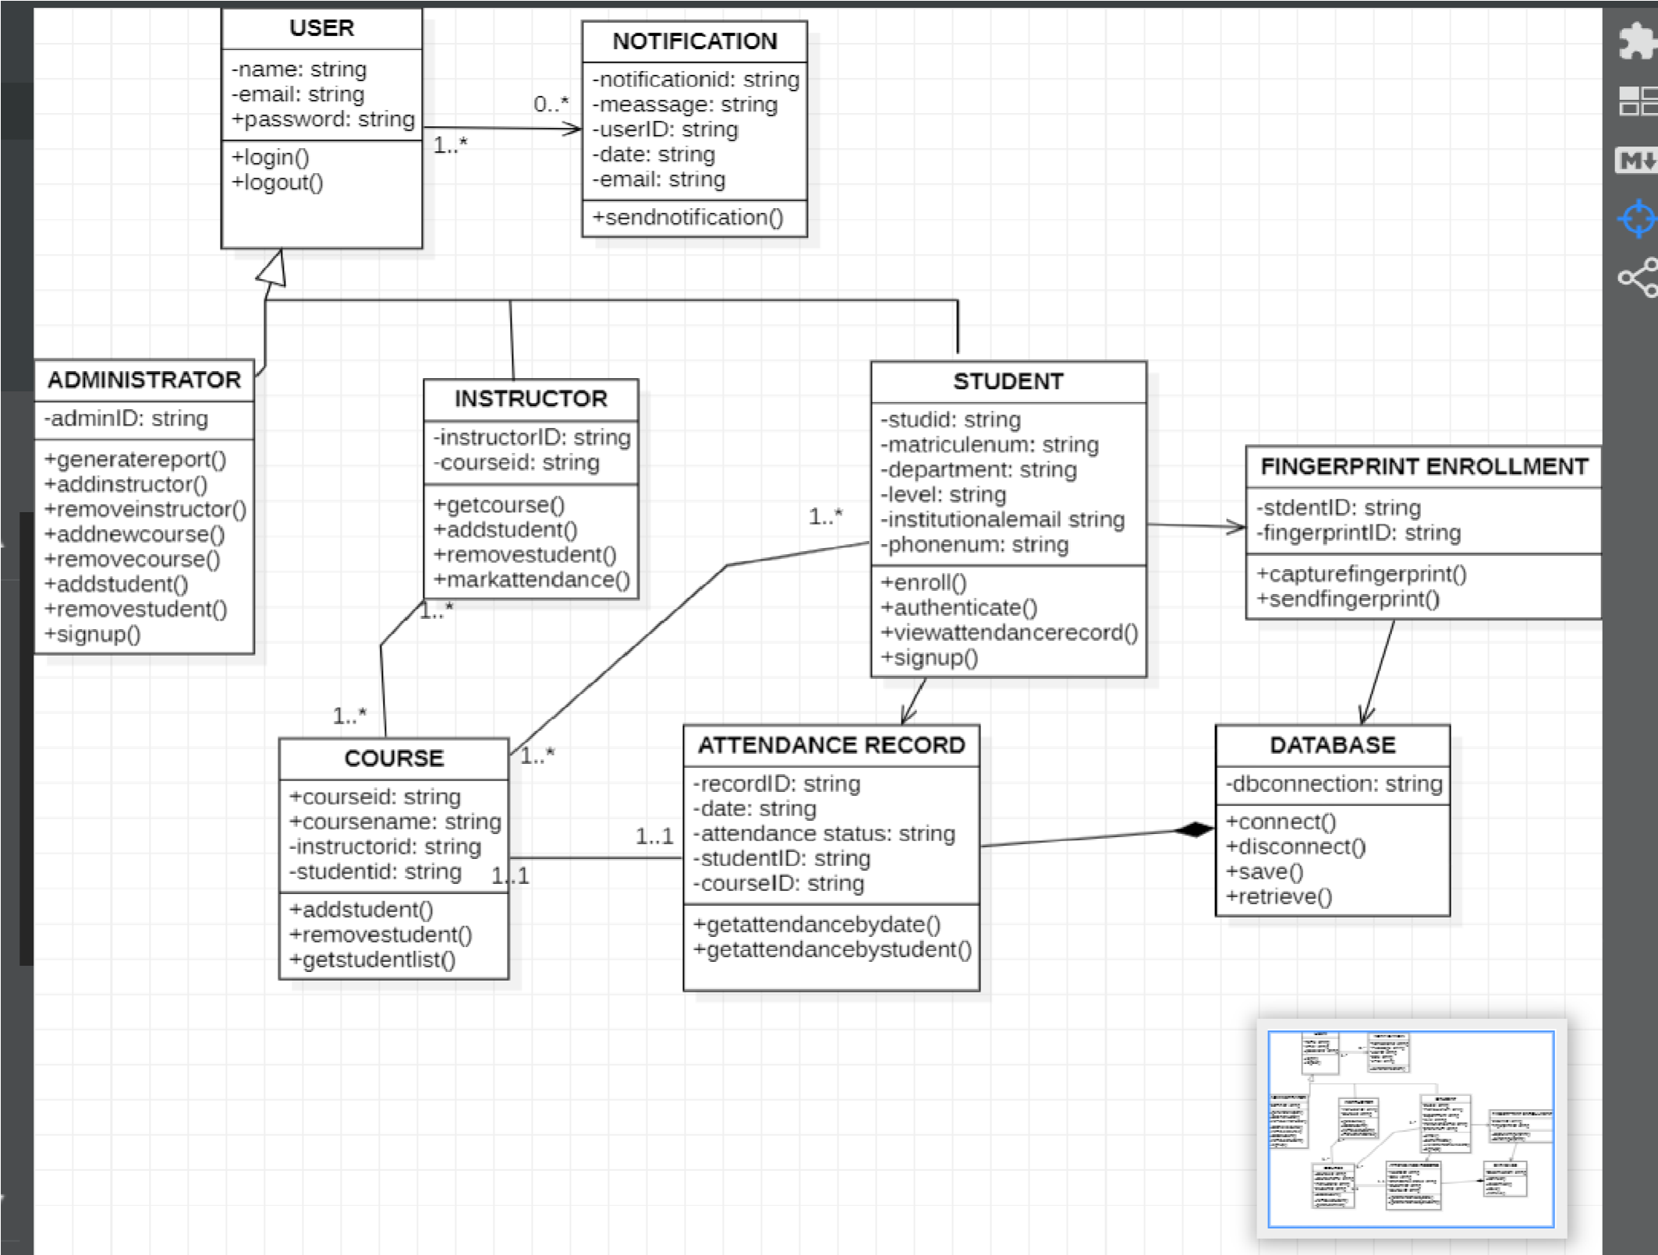
Class Diagram

Slide 16
Deployment Diagram Overview
Deployment diagram are typically used to visualize the physical hardware and software of a system. Using it you can understand how the system software will be physically be deployed on the hardware.

Slide 17
Main Component
The main component in this our deployment diagram are:
Client mobile device
Server device ( Lecturer Tablet)
Application server
Database server
Computer device
Push notification server

Slide 18
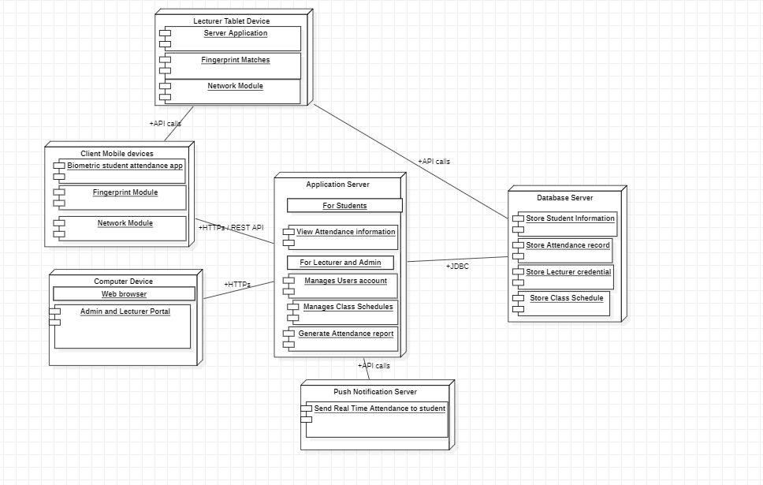
Deployment diagram

Slide 19
Interaction between the client device, server device and database
Account creation & fingerprint enrollment
Attendance making

Slide 20
Interaction between the client device, computer device, application server and database
Involve the student accessing the biometric student attendance app on their smartphone as well as the lecturer and admin accessing their portal on the web browser which then communicate with the application server over the web to perform tasks

Slide 21
In conclusion, the system modeling and designs process for our biometric student attendance mobile application have been instrumental in creating a robust and efficient solution for attendance tracking in educational institutions.

Slide 22
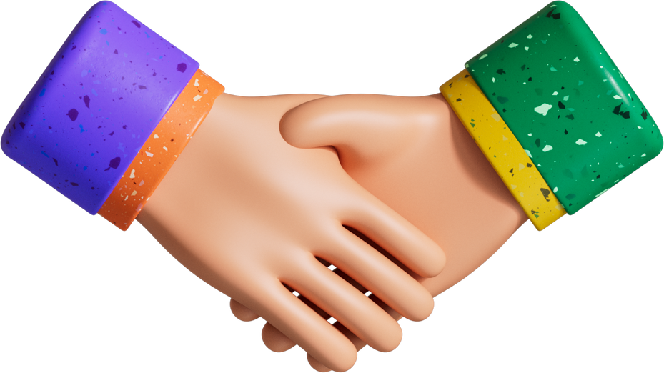
Thank you

